Slide 1
Cell Signaling

Slide 2
Eyeless
Cells can exist as single celled organisms or be part of a multi-cellular organism
How do they know what is happening around them?
Cells do not have ‘eyes’, ‘noses’, or ‘ears’
Answer: Cells communicate with others and have mechanisms to sense their environments using a variety of methods as we will uncover - whichever method is used it involves a very important principle called SIGNAL TRANSDUCTION

Slide 3
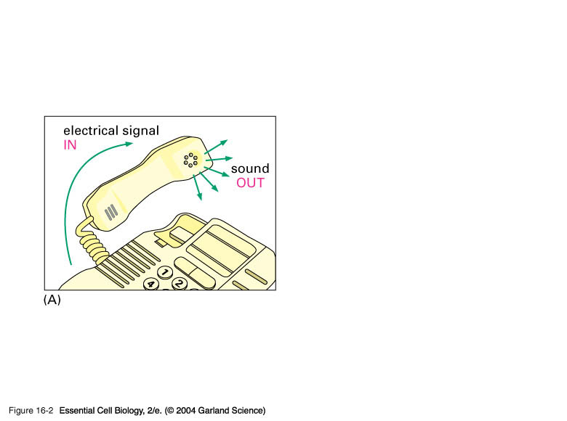
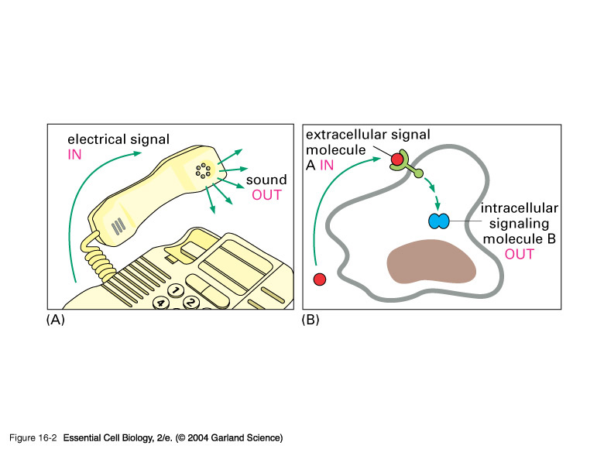
16_02_Signal_transduct.jpg
Signal Transduction
The conversion of a signal, of some type, from one physical form to another.
Electrical impulses are converted to sound waves that we hear
Signal molecules are received by target cells via receptors and converted to other intracellular forms
Notes:
16_02_Signal_transduct.jpg

Slide 4
Cell Signaling types
Endocrine - hormones, long distance
Paracrine - local vicinity
Neuronal - very short distances
Contact-dependent - physical contact
Autocrine - act on self

Slide 5
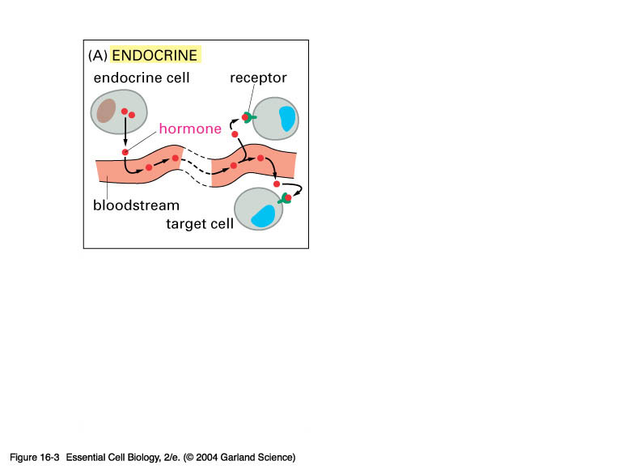
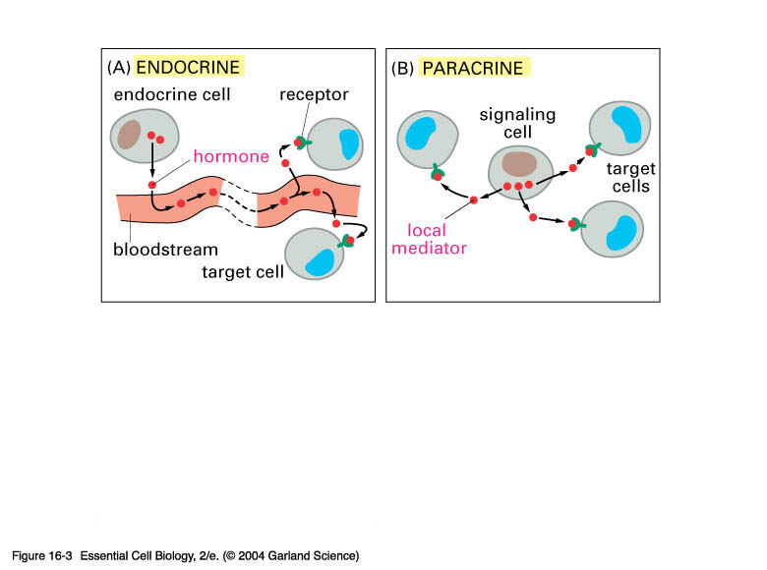
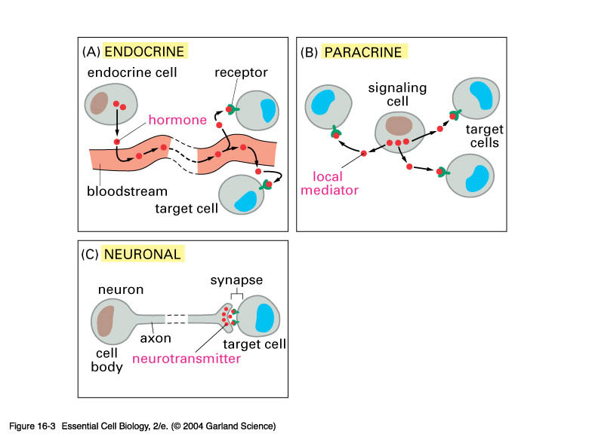
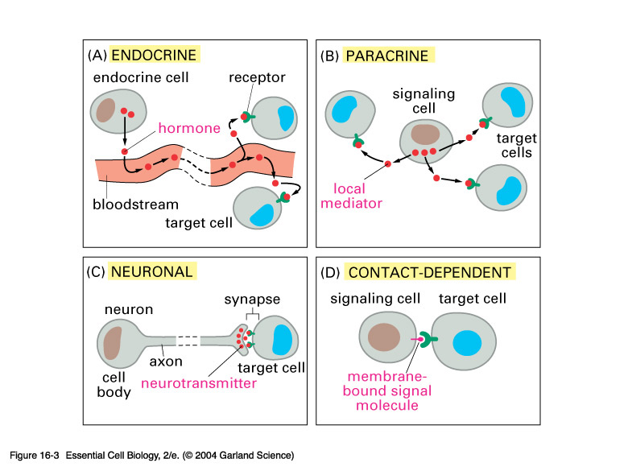
16_03_signal_various.jpg
Notes:
16_03_signal_various.jpg

Slide 6
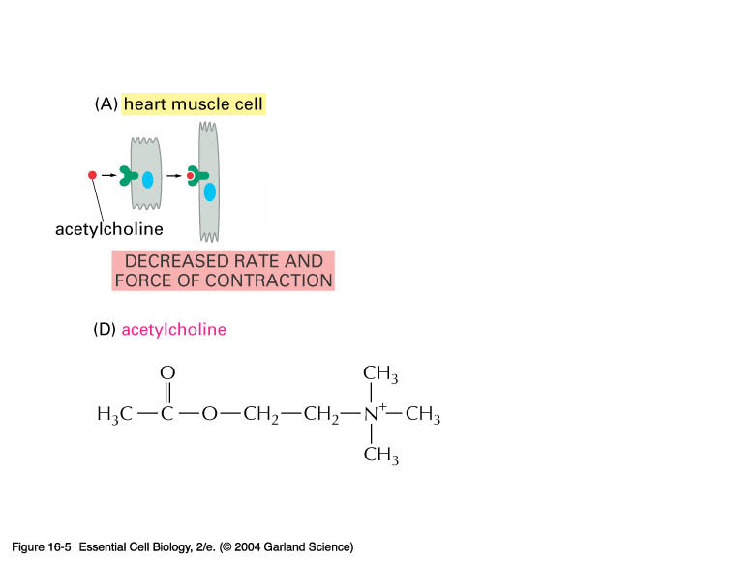
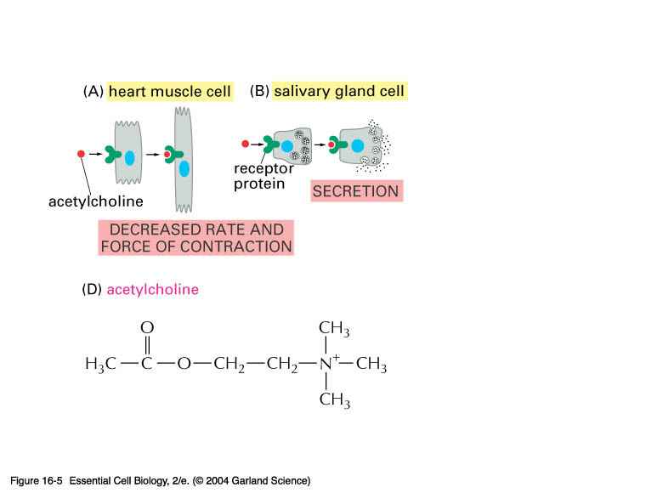
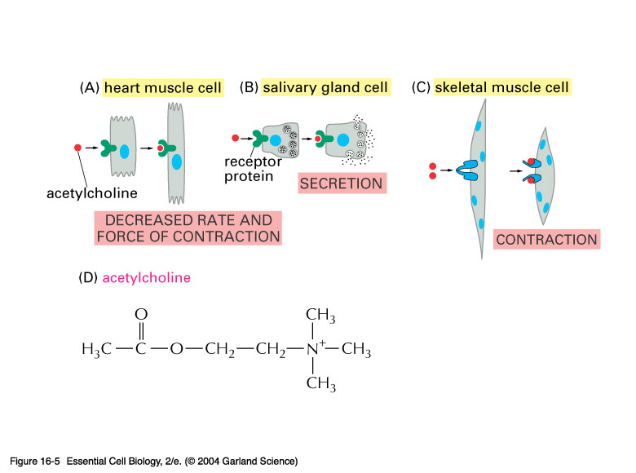
16_05_target_cells.jpg
The same signal molecule may interact with different cells with entirely different effects. Here is an example of acetylcholine
Acetylcholine has a role in both branches of your nervous system
It has a half-life of about 2 minutes.
Notes:
16_05_target_cells.jpg

Slide 7
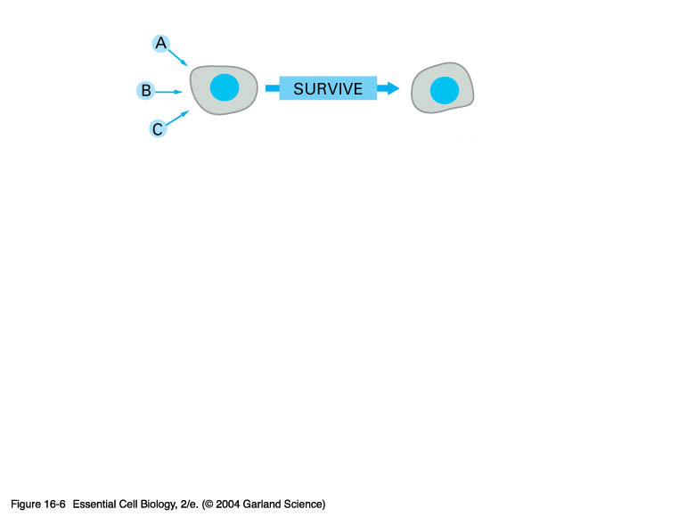
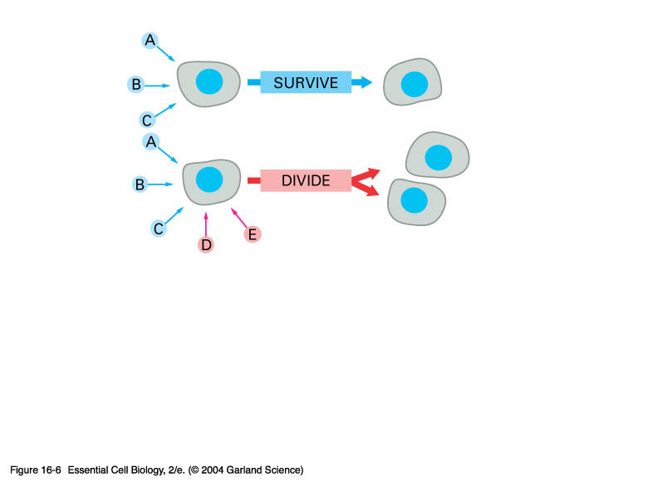
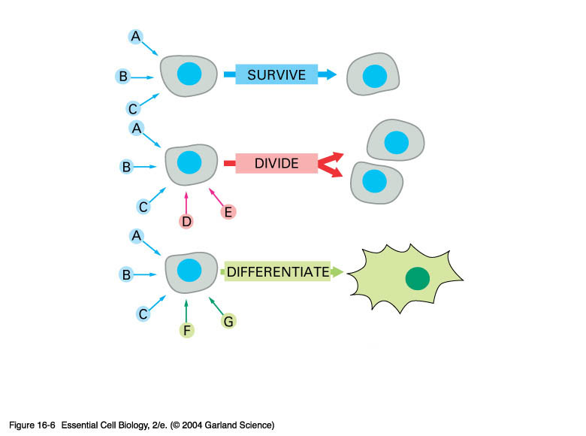
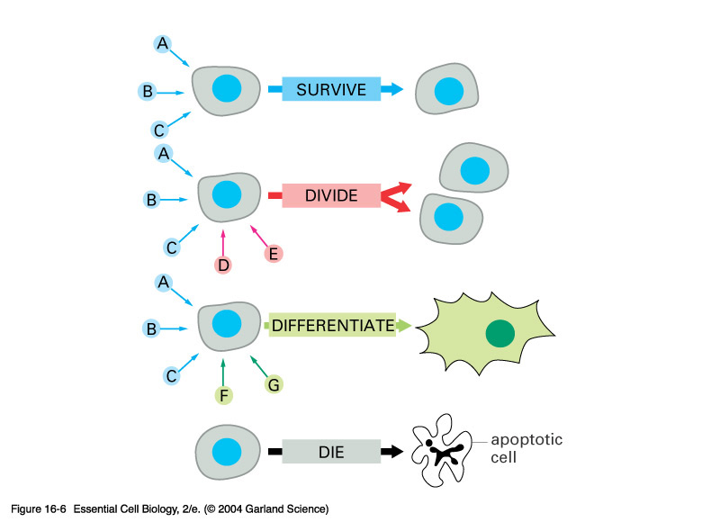
16_06_extracellular_sig.jpg
Cells generally respond to a combination of signals. The same cell may have different outcomes to various signal combinations
Cells that DO NOT RECEIVE SIGNALS DIE
The default pathway=
Notes:
16_06_extracellular_sig.jpg

Slide 8
How do these signals work
At which level?
Where?
How many?

Slide 9
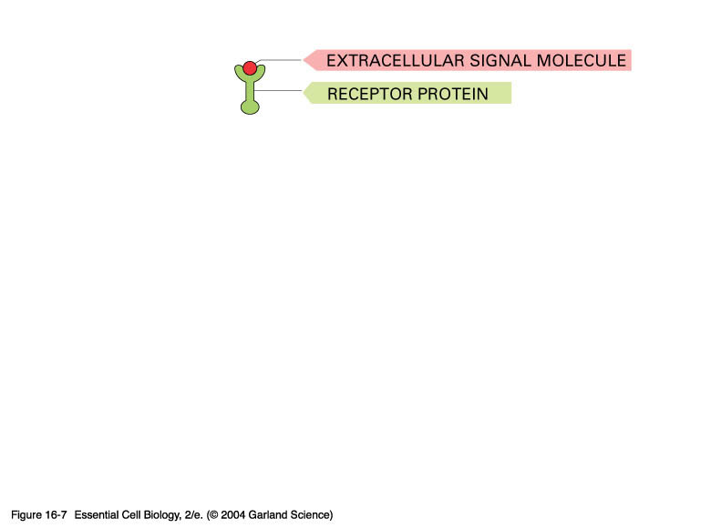
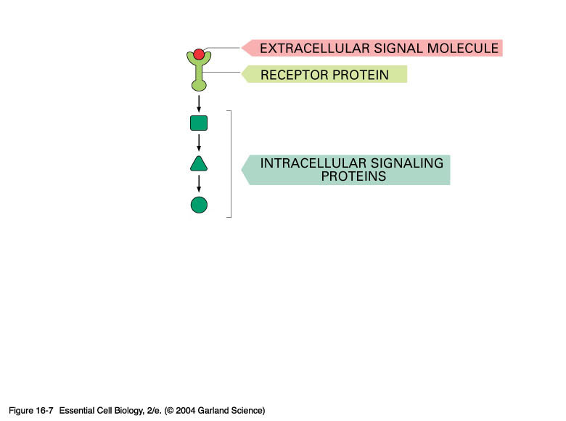
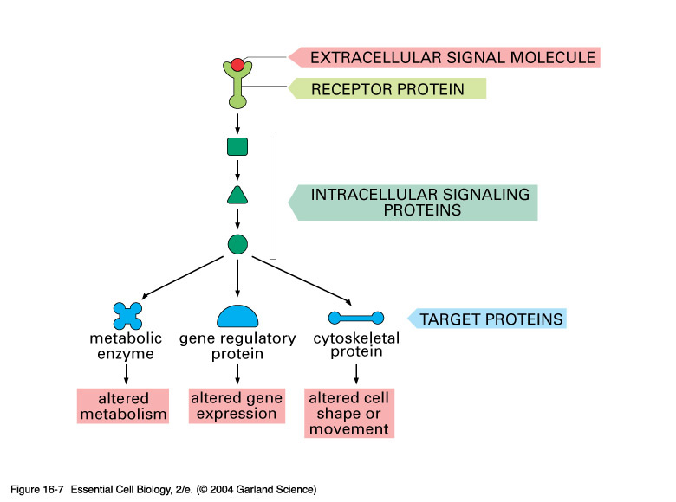
16_07_change_behavior.jpg
General Plan of Action
Notes:
16_07_change_behavior.jpg

Slide 10
Each cell responds to a limited set of signals - why?
These signals change the activity of internal cellular proteins which chances the behavior of the cell
These signals follow a chain of events known as the signal cascade
  A system of relaying information from the site of reception to the point of action
  Normally the signal is amplified too - a small input is quickly converted to a large response

Slide 11
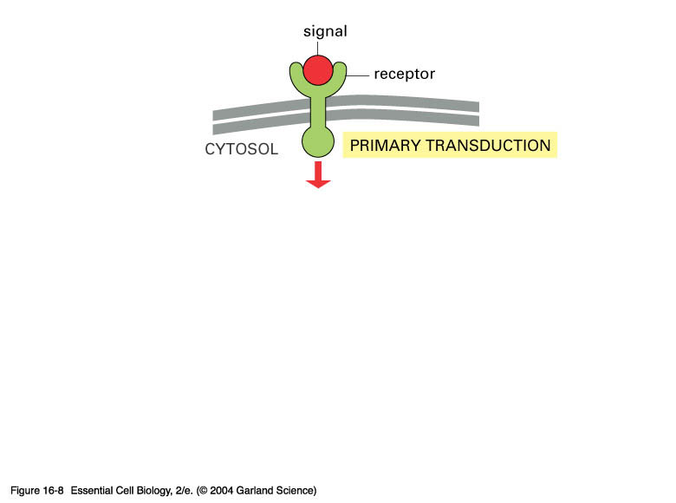
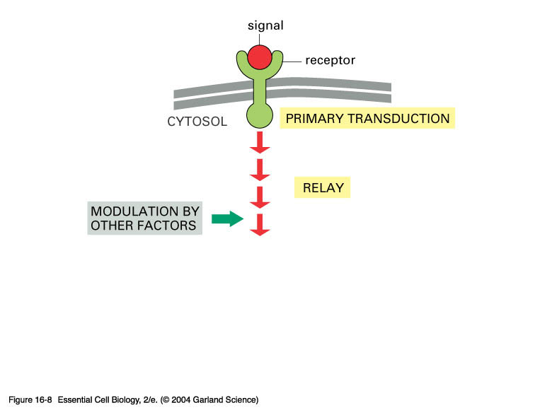
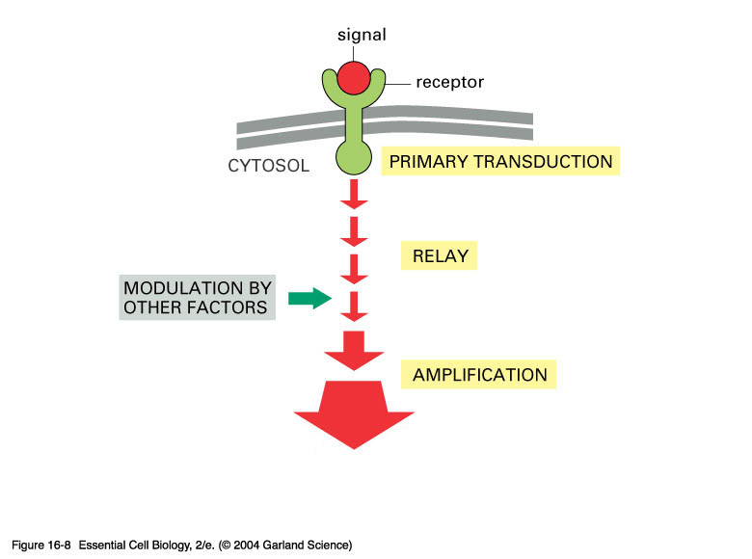
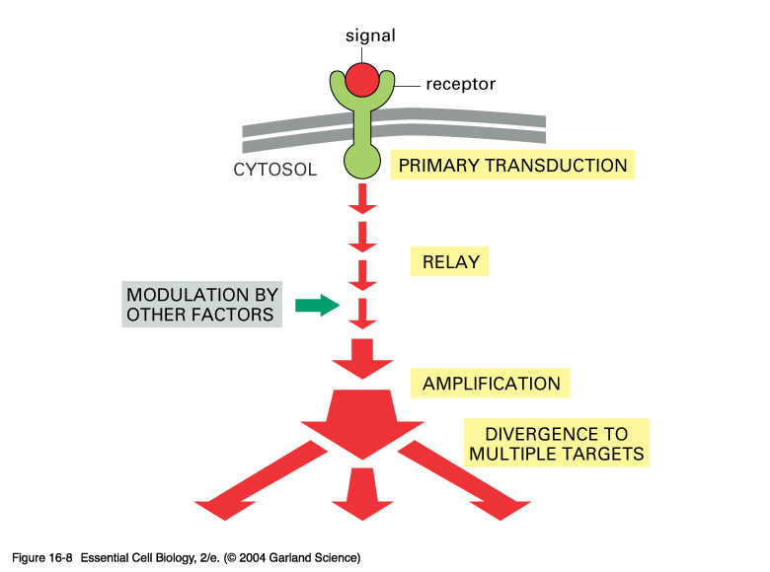
16_08_cascades.jpg
General Overview 2
Notes:
16_08_cascades.jpg

Slide 12
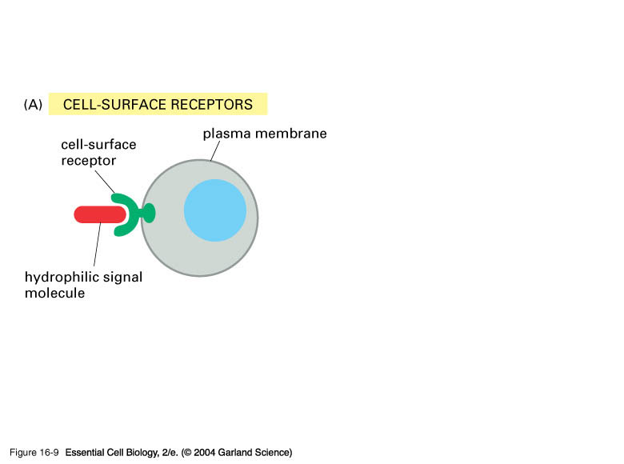
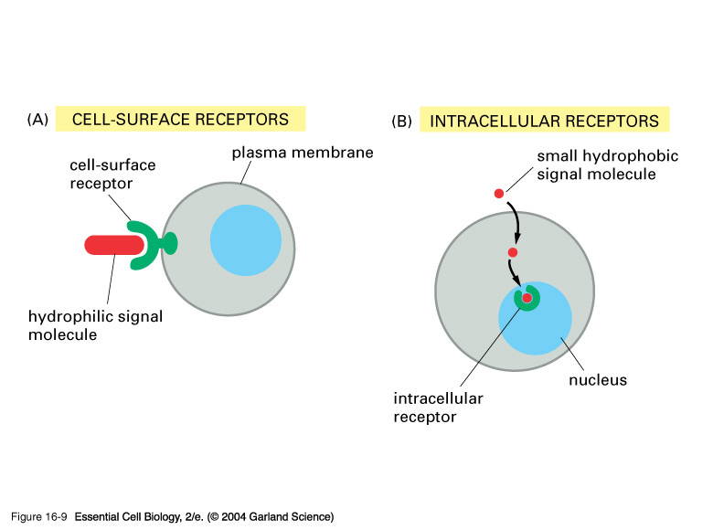
16_09_molecules_bind.jpg
Some signal molecules act at the cell surface whilst others can enter the cell readily and act inside such as steroids.
The red signal molecule has a target receptor to which it binds and that’s that. Note that it is usually hydrophilic.
Other receptors enter the cell.
If they must pass through the membrane without P’s they are..
Notes:
16_09_molecules_bind.jpg

Slide 13
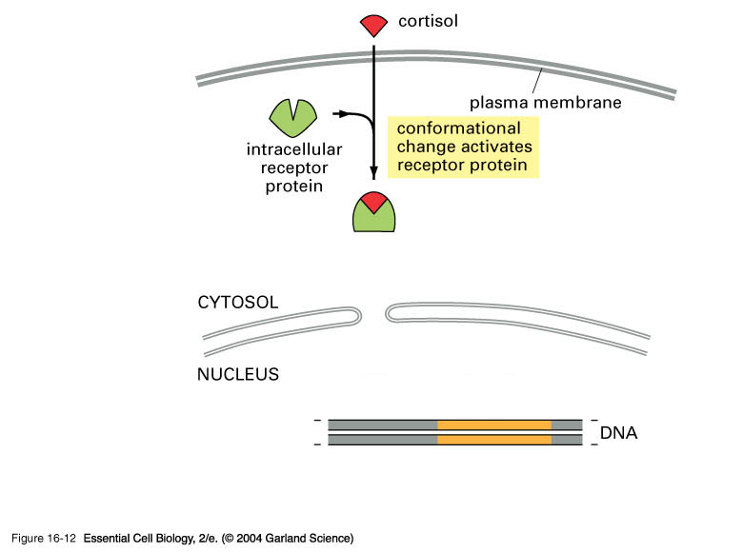
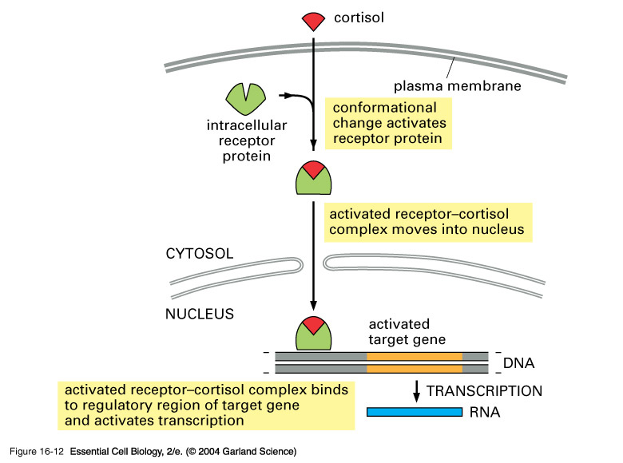
16_12_cortisol.jpg
A simple example of how a steroid works.
-The signal can enter the cell through the membrane and bind to its target protein.
-This is now able to enter through the nuclear pore and control transcription directly of certain target genes
Notes:
16_12_cortisol.jpg

Slide 14
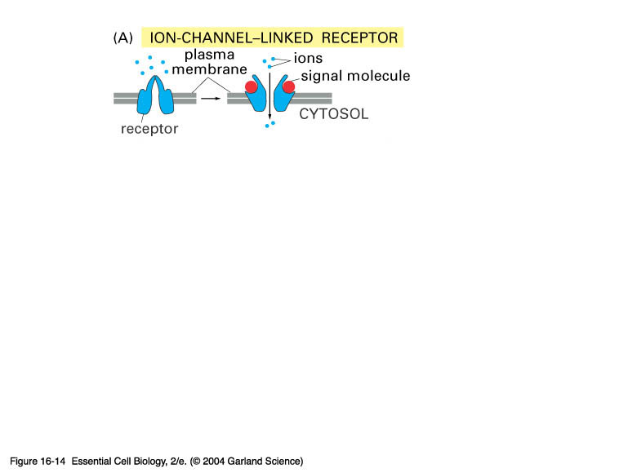
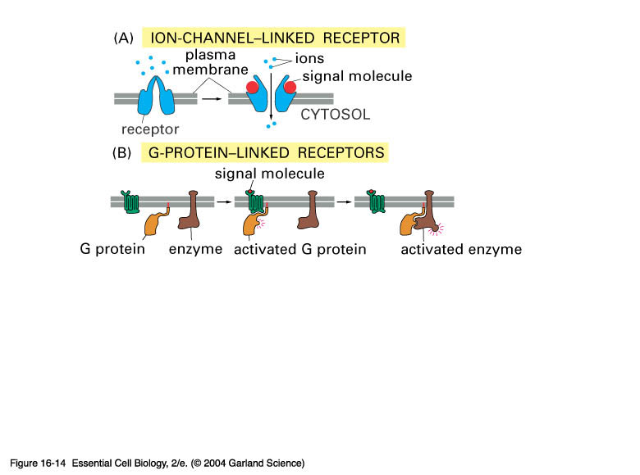
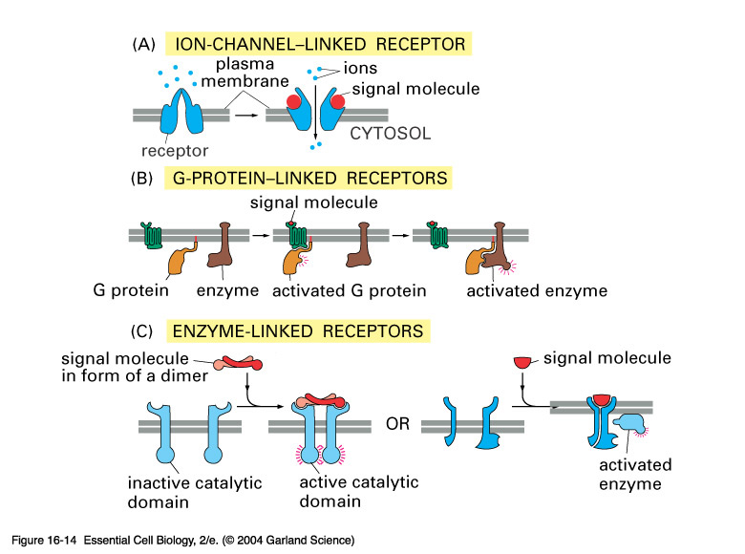
16_14_3_basic_classes.jpg
There are three classes of cell surface receptor:
ion-channel linked
G-protein linked
Enzyme linked
Notes:
16_14_3_basic_classes.jpg

Slide 15
All nerve impulses are generated via ion-channel linked receptors
  The release of neurotransmitter causes the ion-channel on the target neuron to allow the passage of ions (which?) into the cell. This action is propagated through the nerve cell along its axon.

Slide 16
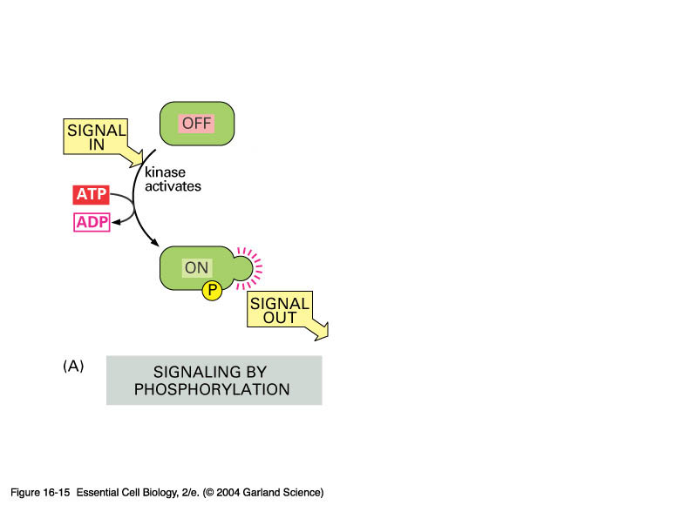
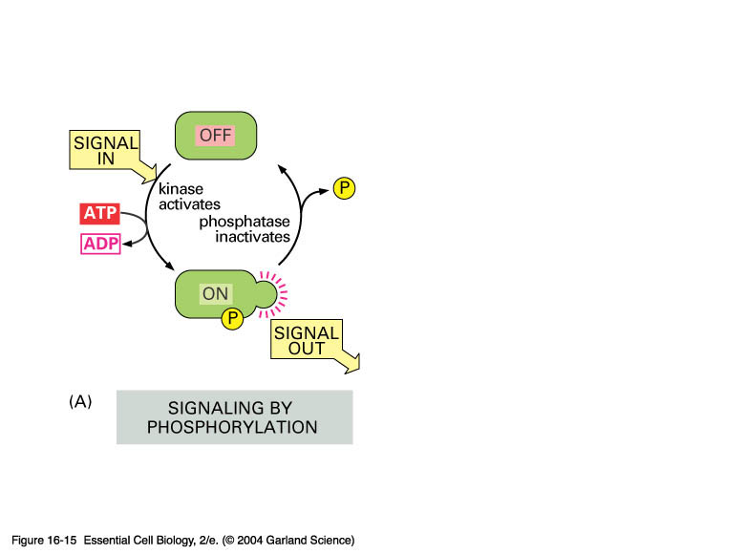
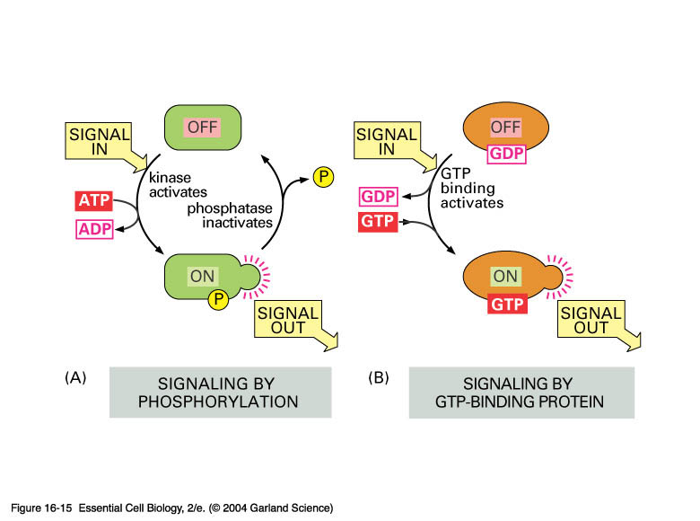
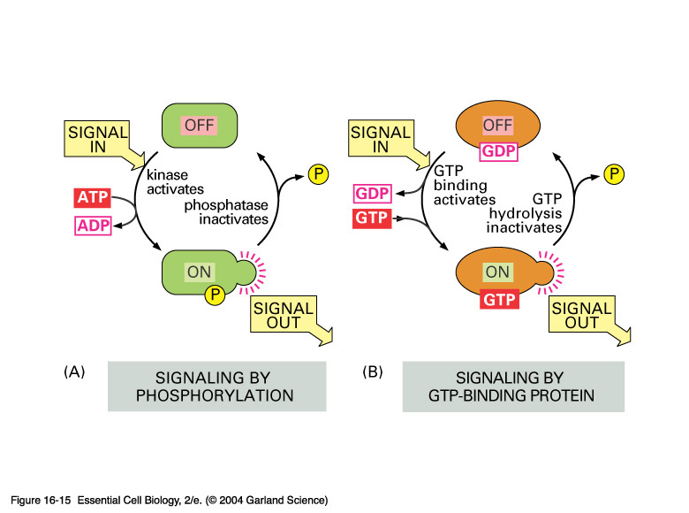
16_15_molec_switches.jpg
Many interactions taking place within the cell act to turn on or off proteins. These are known as molecular switches.
Notes:
16_15_molec_switches.jpg

Slide 17
G-protein linked receptors
These form the largest class of cell-surface receptors so far identified - with many hundreds known
They have a common structure
  A single polypeptide that passes 7 times back and forth across the plasma membrane
These receptors can bind to all sorts of signal molecules - proteins, small peptides, amino acids, even fatty acids
When bound by its extracellular signal molecule the receptor undergoes a physical change, which permits it to activate a G-protein located in the inside surface of the plams membrane

Slide 18
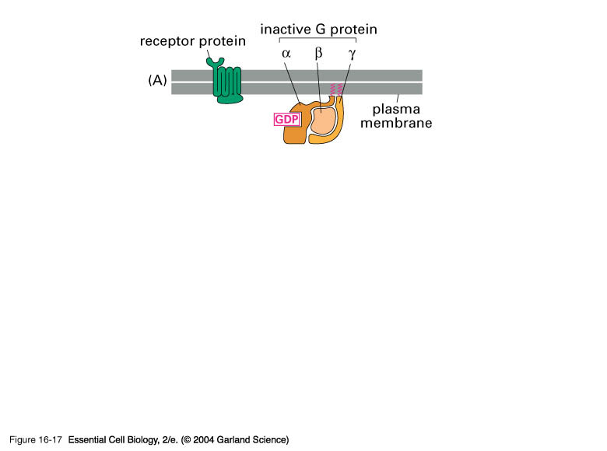
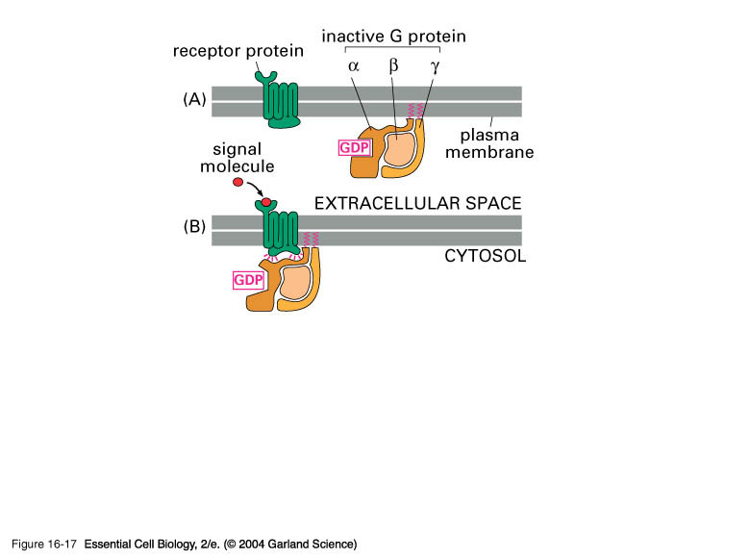
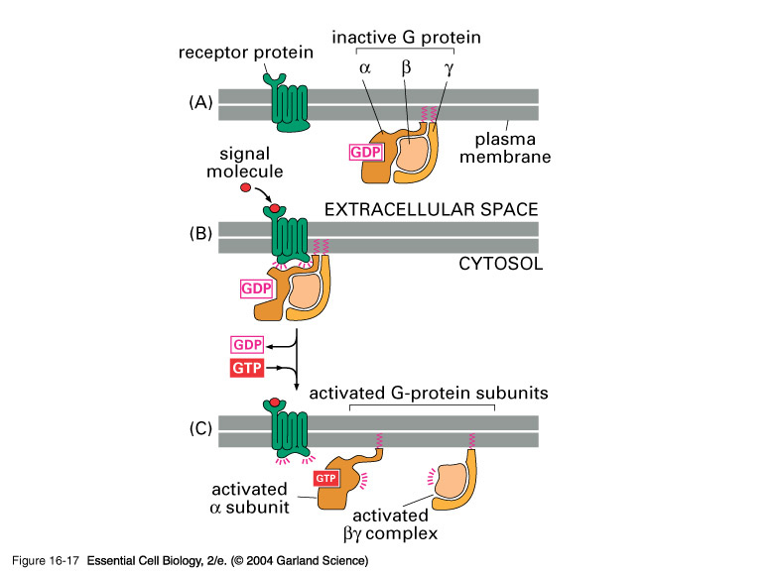
16_17_Gprot_dissociate.jpg
The key to the regulation of the cell is the behavior of the G-protein.
It is a trimer of three subunits -
When the three units are associated with each other there is no activity
When the receptor is activated it causes the disassociation of the subunits by replacing the bound GDP with GTP. Each of the two subunits is active to catalyze other cellular molecules.
The GTP is eventually converted to GDP and the 3 subunits reunite.
Notes:
16_17_Gprot_dissociate.jpg

Slide 19
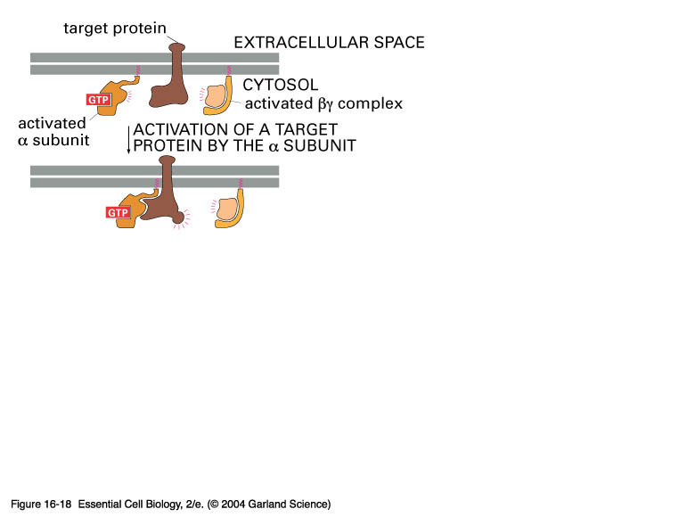
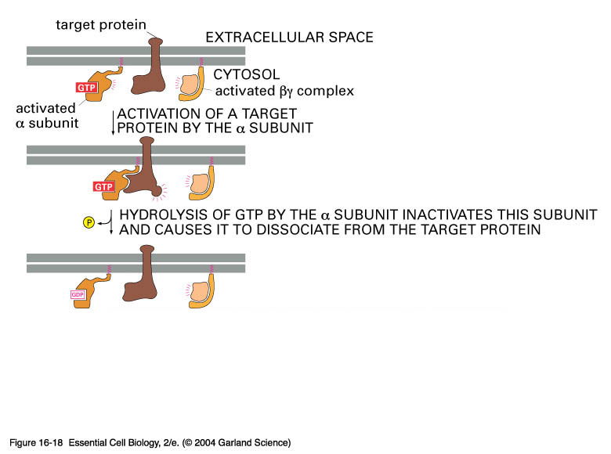
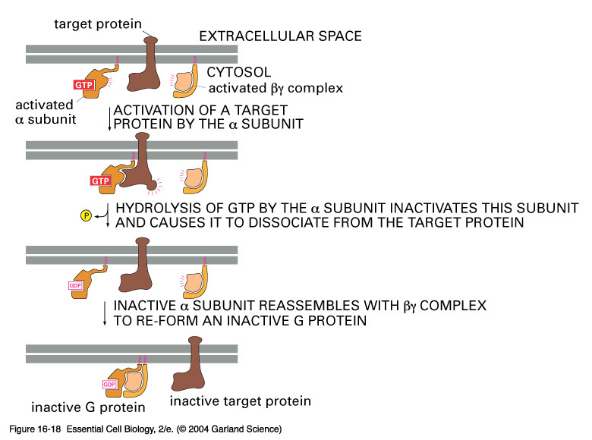
16_18_Gprot_subunit.jpg
Continued from previous - details on how the subunit is inactivated
Notes:
16_18_Gprot_subunit.jpg

Slide 20
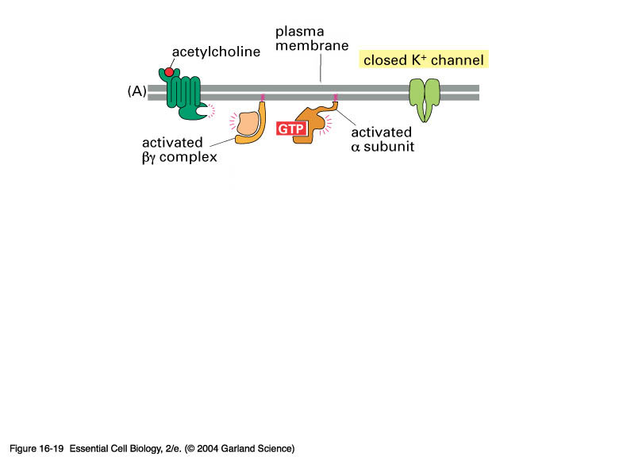
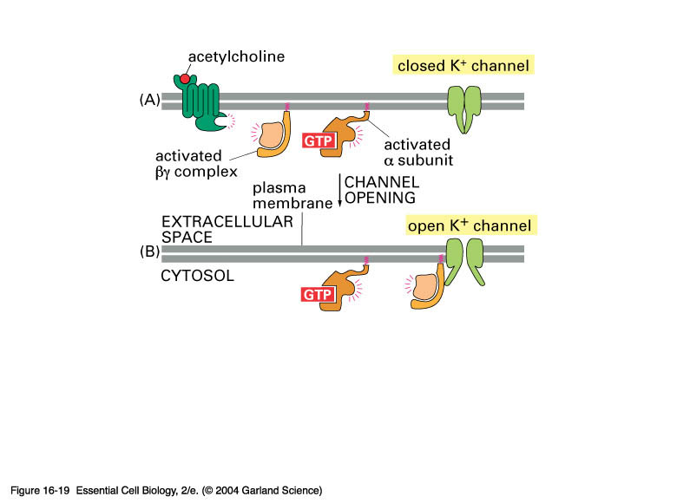
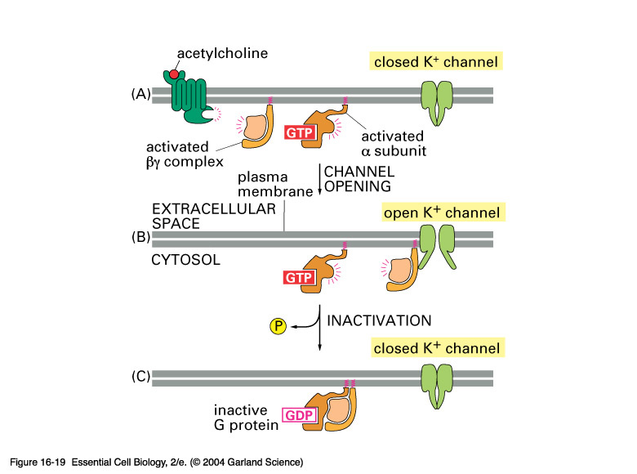
16_19_open_K_chan.jpg
Some G-proteins activate ion channels.
Here we see a schematic showing how the K pump in the heart is controlled
Notes:
16_19_open_K_chan.jpg

Slide 21
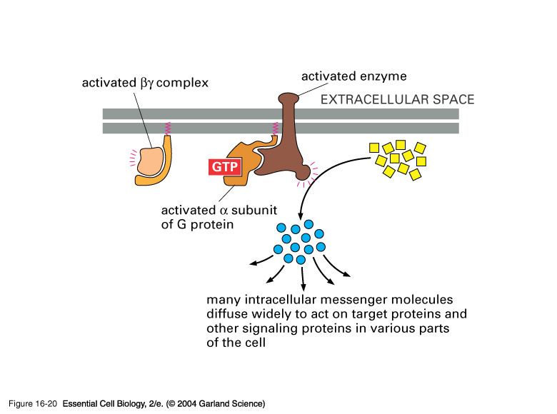
16_20_second_messeng.jpg
Some G proteins activate enzymes directly
Notes:
16_20_second_messeng.jpg

Slide 22
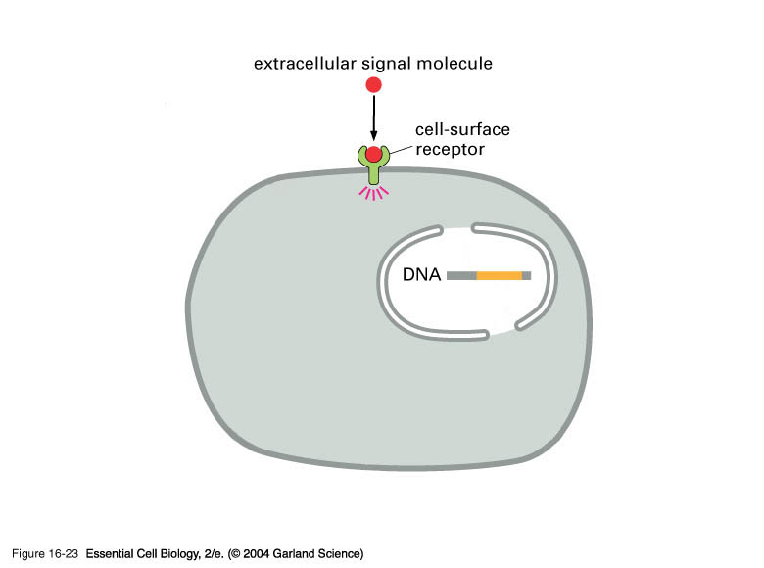
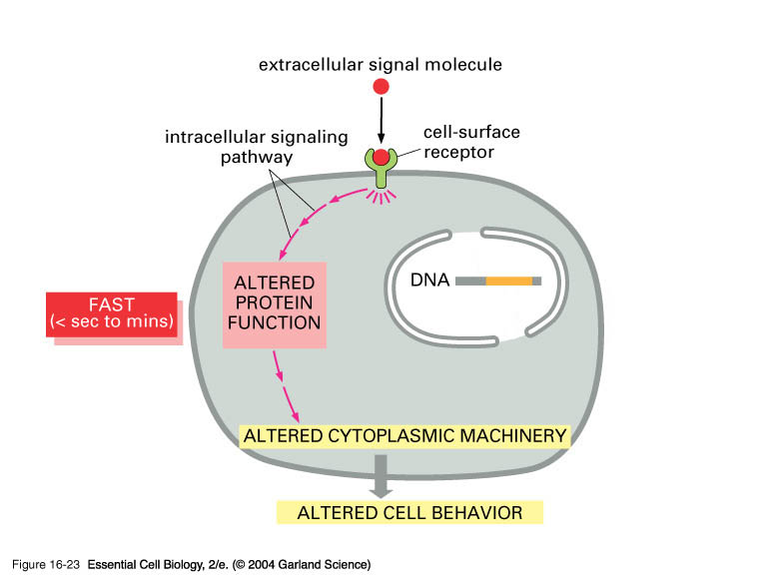
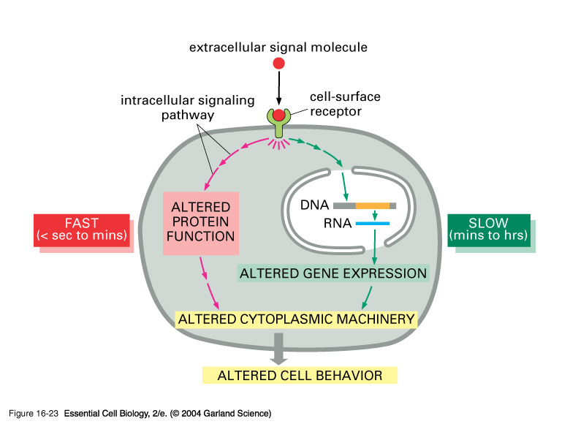
16_23_slowly_rapidly.jpg
Some cellular responses are quick, whilst others are slow.
Notes:
16_23_slowly_rapidly.jpg

Slide 23
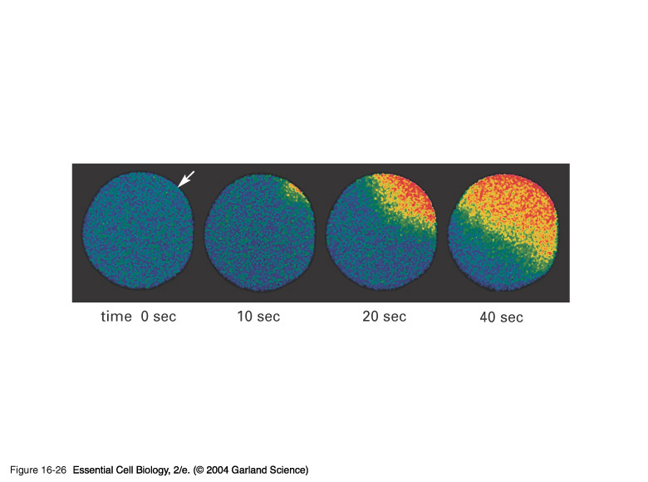
16_26_Fertilization.jpg
Calcium has a very important role to play as an intercellular messenger.
As we know the concentration of calcium is extremely low in the cytoplasm of a typical cell, compared to the outside and to that of the ER.
In this example fertilization results in the wave of receptors opening up to permit the influx of calcium into the cell. This results in a change in the cell surface which both initiates cell division and prevents other sperm from entering the cell.
Notes:
16_26_Fertilization.jpg

Slide 24
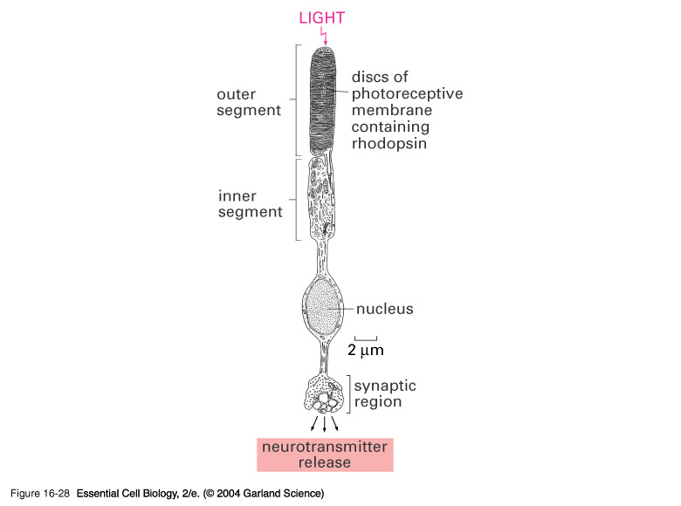
16_28_photoreceptor.jpg
The speed at which signaling cascades operate is clearly illustrated by the photoreceptors of the eye.
The human eye has two forms of receptors - rods and cones
The cones are further divided depending on the wavelength of light they respond to - red, green, and blue
Notes:
16_28_photoreceptor.jpg

Slide 25
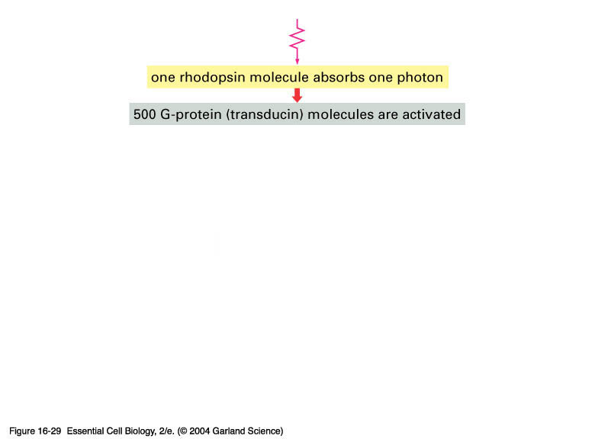
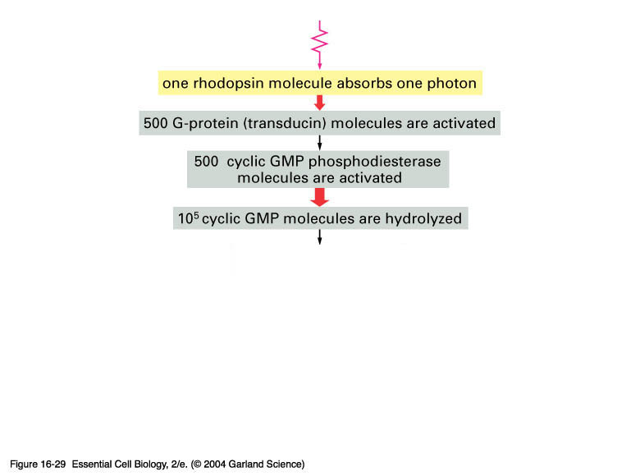
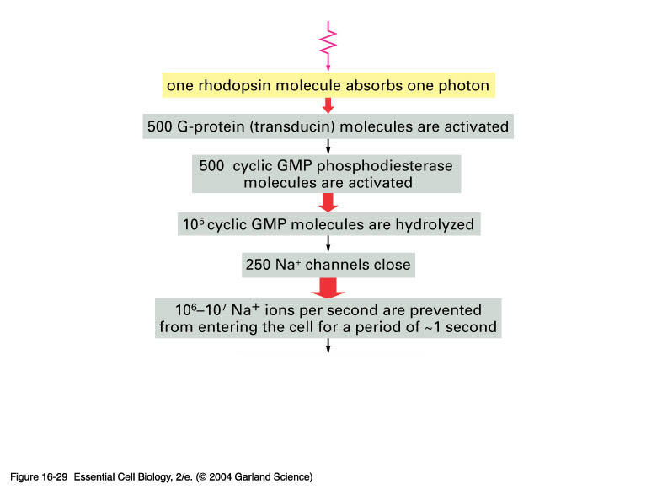
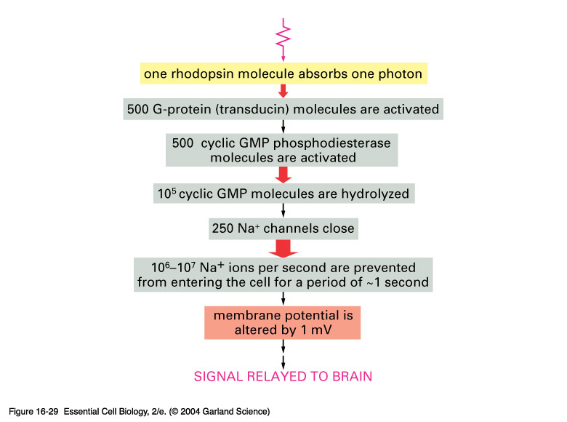
16_29_amplifies_light.jpg
Notes:
16_29_amplifies_light.jpg

Slide 26



16_30_rec_tyro_kinase.jpg
The more complex receptors are illustrated by tyrosine kinases. These act in trans on each other to phosphorylate certain regions. The phosphorylated regions bind other factors in the cell.
Notes:
16_30_rec_tyro_kinase.jpg

